Slide 1
BISSIT 2022: Machine learning and artificial intelligence
Michal Hradiš

Slide 2
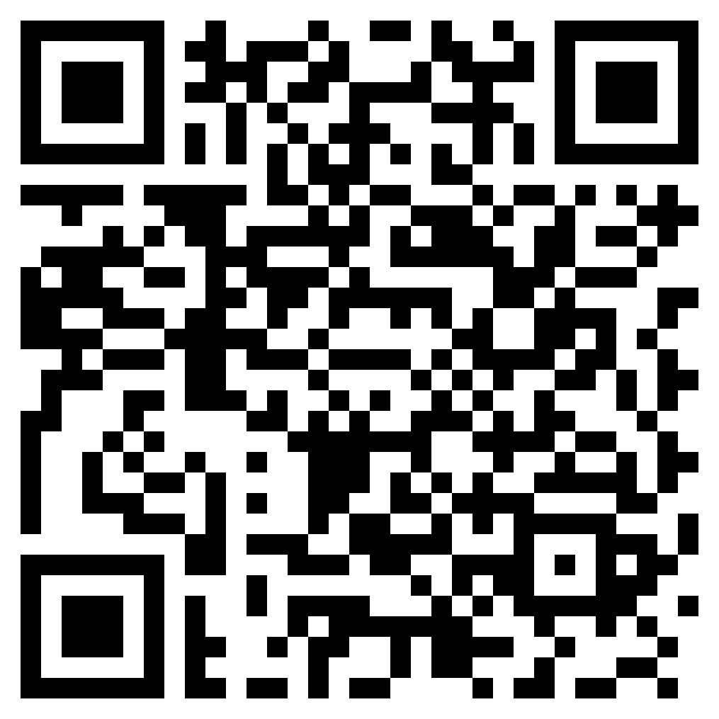
Wifi, login, google drive, …
VUT (BUT) login – do you have them?
WiFi – Create EduRoam accout at wis.fit.vutbr.cz
Google Drive - All lectures, other materials, and documents

Slide 3
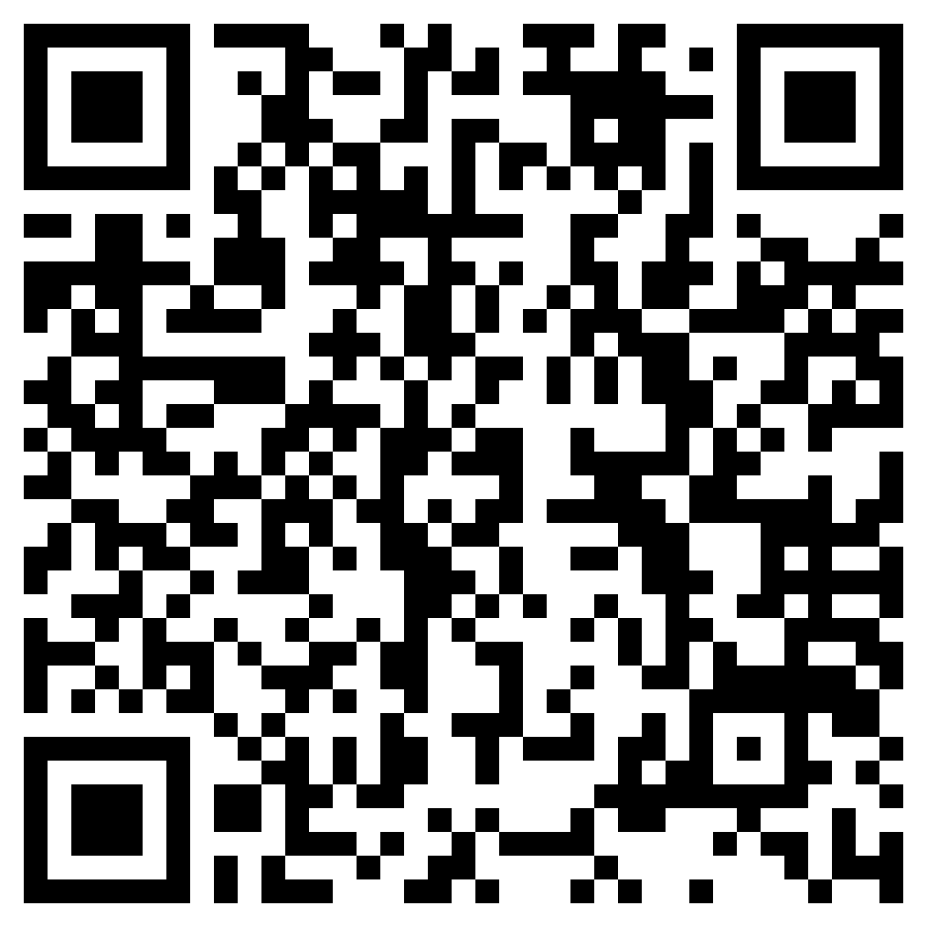
Questionaire

Slide 4
Schedule
Date |  | 9:00 -12:00 AM | 13:30 - 16:30 PM
7/11/2022 | Mon | Registration + Enrolment Welcome by the FIT (dean/vice-dean) Presentation of FIT FIT Guided tour | Brno City Rally by ESN BUT start at 14:00 (dormitory, Purkynova 93)
7/12/2022 | Tue | AI and ML introduction Michal Hradiš | Python Karel Beneš
7/13/2022 | Wed | Python Karel Beneš | Basics in ML Karel Beneš
7/14/2022 | Thu | Basics in ML Karel Beneš | CNNs Michal Hradiš
7/15/2022 | Fri | CNNs Michal Hradiš | NXP
7/16/2022 | Sat | Guided tour: Prague
7/17/2022 | Sun | Free time activities

Slide 5
Schedule
7/18/2022 | Mon | Python (jupyter, colaboratory) Martin Kišš / Jan Kohút | Python (NUMPY) Martin Kišš / Jan Kohút
7/19/2022 | Tue | Audio and speech processing Kateřina Žmolíková | Speech to text processing Karel Veselý
7/20/2022 | Wed | Image/video processing Adam Herout | Image/video processing Adam Herout
7/21/2022 | Thu | Natural Language Processing Fajčík Martin | Natural Language Processing Fajčík Martin
7/22/2022 | Fri | Genetic Programming Michal Bidlo | Genetic Programming Jan Husa
7/23/2022 | Sat | Free time activities
7/24/2022 | Sun | Guided tour: Moravian Carst
7/25/2022 | Mon | Project work Michal Hradiš | Project work Michal Hradiš
7/26/2022 | Tue | Project Presentation Michal Hradiš | Evaluation of Summer School Awarding Certificates

Slide 6
Grading
Short Tests ~ 40%
4 multiple choice questions for each topic
Project ~ 60%
Teams of 3 students
Any ML, AI, video/audio/text processing topic
We will provide suggested topics, but you can choose your own topic
You will choose topic on 15.7. (this Friday)
Result: Presentation, short report with results

Slide 7
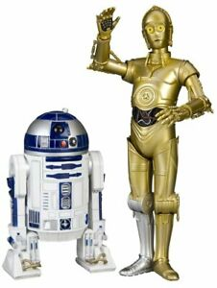
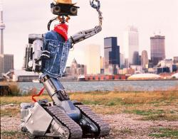
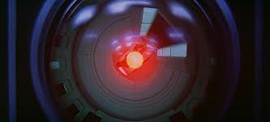
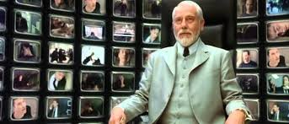
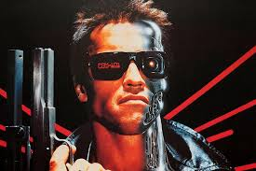
The big question

Slide 8
AI in your everyday Life?

Slide 9

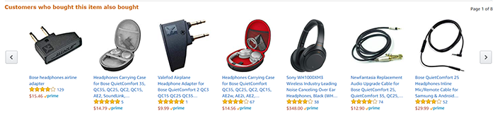
AI in everyday Life?
Search engines
Spam filters
Recommendation - Youtube / Amazon / Facebook / …
Speech recognition / speech synthesis
Dialogue systems / Digital voice assistants
Spell checking
Translation
Driving assistants / self-driving cars
Face recognition / identification
Fraud detection
...

Slide 10
What is AI?
AI agents - general/strong AI: How can we create intelligence?
Tools - narrow AI: How can we create useful tools?

Slide 11
Strong AI: What is intelligence?

Slide 12
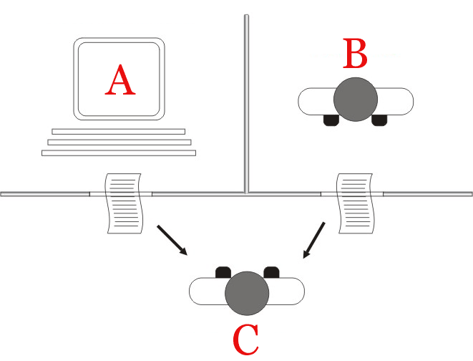
Strong AI: What is intelligence?
Turing test
A. M. TURING: Computing machinery and intelligence. Mind, 1950. https://doi.org/10.1093/mind/LIX.236.433

Slide 13
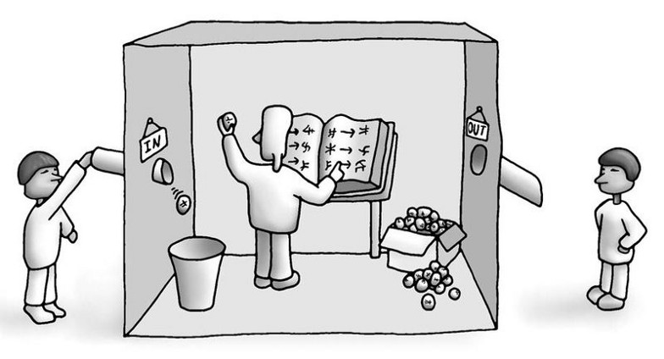
Strong AI: What is intelligence?
Turing test Chinese room
A. M. TURING: Computing machinery and intelligence. Mind, 1950. https://doi.org/10.1093/mind/LIX.236.433
John Searle: Minds, Brains, and Programs. 1980.

Slide 14
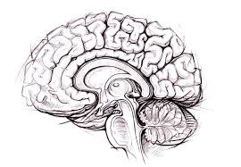
What is intelligence?
Motor control
Perception
Language
Reasoning
Learning
Intuition
Prediction
Goals
Imagination
Self aware
Emotions
Consciousness

Slide 15
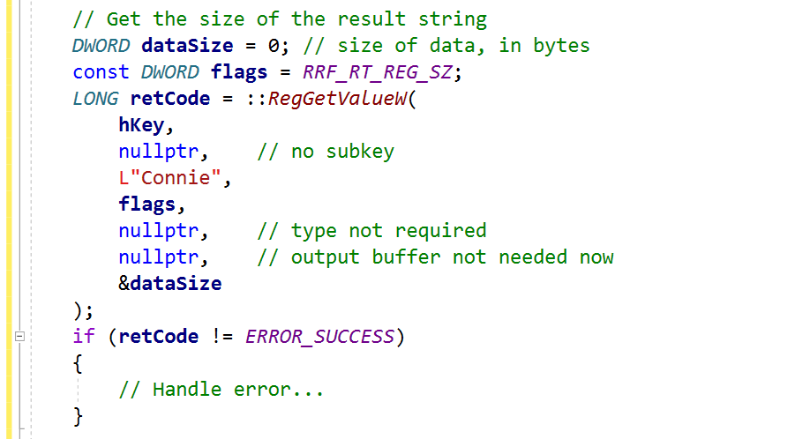
How far are we?
?
Tiku, The Google engineer who thinks the company’s AI has come to life, The Washingon Post, 2022. https://www.washingtonpost.com/technology/2022/06/11/google-ai-lamda-blake-lemoine/
T Mikolov, A Joulin, M Baroni, A roadmap towards machine intelligence, International Conference on Intelligent Text Processing and Computational …, 2016. https://arxiv.org/abs/1511.08130
Rosa et al.: GOOD version 1 AI AGENT DEVELOPMENT ROADMAP. 2016. https://www.goodai.com/wp-content/uploads/2019/10/2f0a43_091d76d2b0354b0db4d88c3a57fdf76d.pdf

Slide 16
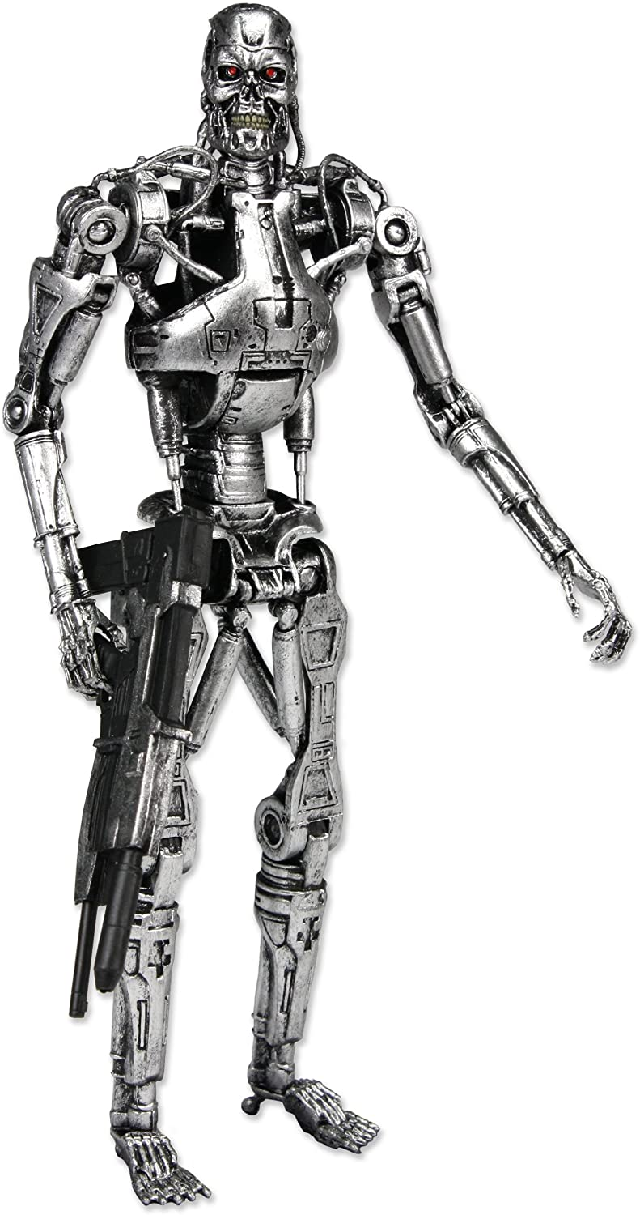
Dangers
Elon Musk: “Mark my words — A.I. is far more dangerous than nukes” https://www.youtube.com/watch?v=5taE_br3Vr8
Stephen Hawking: "The development of full artificial intelligence could spell the end of the human race."
It is not just AI singularity and machines taking over :)

Slide 17
AI tools are transformative and possibly unethical
Automation-spurred job loss
Privacy violations
Credibility (e.g. Deepfakes, automated chat bots)
Social bubbles
Algorithmic bias, discrimination (e.g. caused by bad data)
Socioeconomic inequality
Weapons automatization

Slide 18
What is AI
Buzz word :)
A group of science fields which strive to solve difficult “human level” tasks
Set of useful tools and products
A goal we are striving towards
Possible danger to human kind

Slide 19
History of AI - Two traditions
Logic, discrete knowledge, search, games,
Neuro-inspired, machine learning, distributed knowledge representation

Slide 20
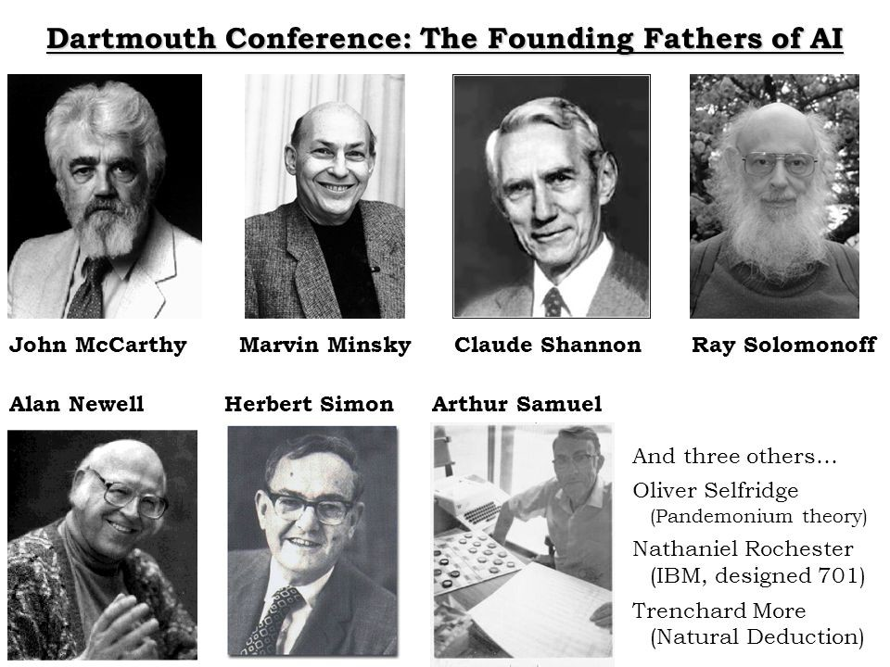
Beginning of Artificial Intelligence
1956: Dartmouth Summer Research Project on Artificial Intelligence; John McCarthy, Marvin Minsky, Claude Shannon, etc.
Every aspect of learning or any other feature of intelligence can be so precisely described that a machine can be made to simulate it.

Slide 21
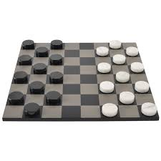
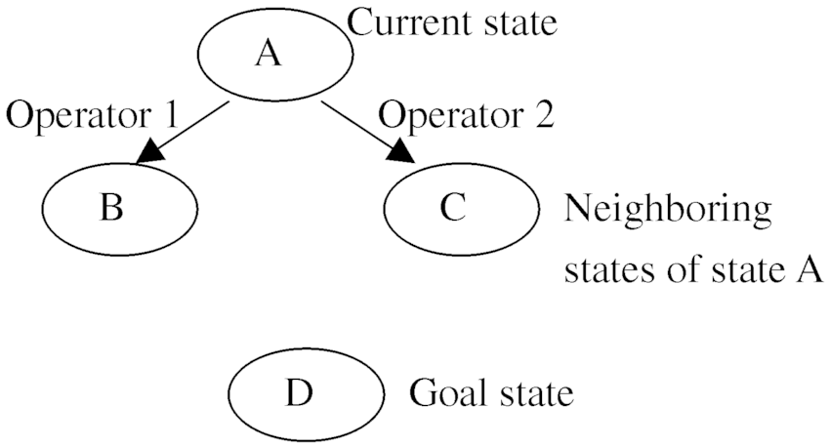
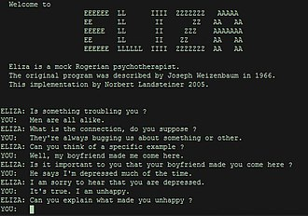
Progress
Checkers (1952): Arthur Samuel program learned (in 1955) move weights and played at strong amateur level. Heuristic + alpha-beta prunning.
Problem solving (1955): Newell & Simon's Logic Theorist: prove theorems in Principia Mathematica using search + heuristics; 1959 General Problem Solver (GPS)
ELIZA (1966): Natural language processing - conversation simulator.

Slide 22
Optimism
Herbert Simon: “Machines will be capable, within twenty years, of doing any work a man can do.”
Marvin Minsky: “Within 10 years the problems of artificial intelligence will be substantially solved.”
Claude Shannon: “I visualize a time when we will be to robots what dogs are to humans, and I'm rooting for the machines.”

Slide 23
Problems
The spirit is willing but the flesh is weak.
(Russian)
The vodka is good but the meat is rotten.
Very limited computation and memory
Real world problems are hard to formalize (abstract)
General logical reasoning --> Exponential search
1966: ALPAC report cut off government funding for MT, first AI winter

Slide 24
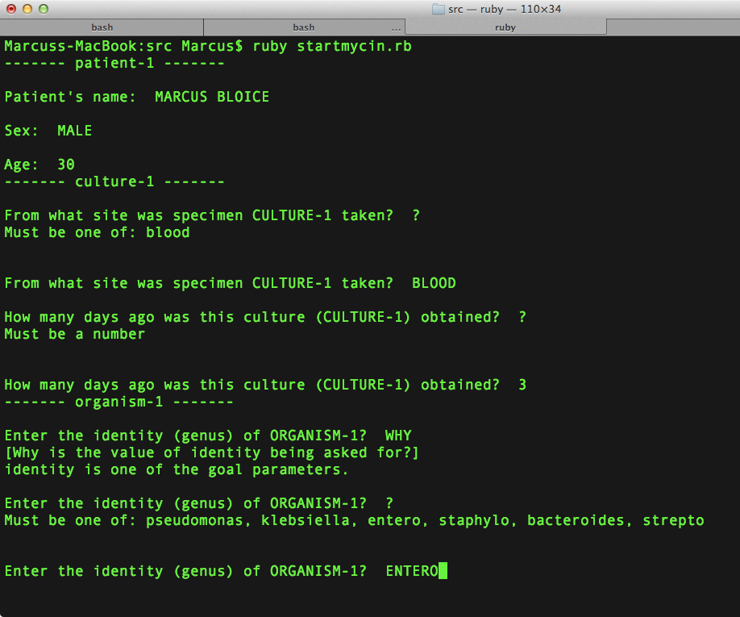
Knowledge-based systems (70s - 80s)
Expert systems
Extract and destil specific domain knowledge from experts in form of rules
if [premises] then [conclusion]
DENDRAL - spectrometry
MYCIN - blood infections

Slide 25
Knowledge-based systems (70s - 80s)
Successful real-world applications with economic impact
Problems:
Real world knowledge is not discrete and rules are not deterministic.
Knowledge base is expensive to create and hard to maintain.

Slide 26
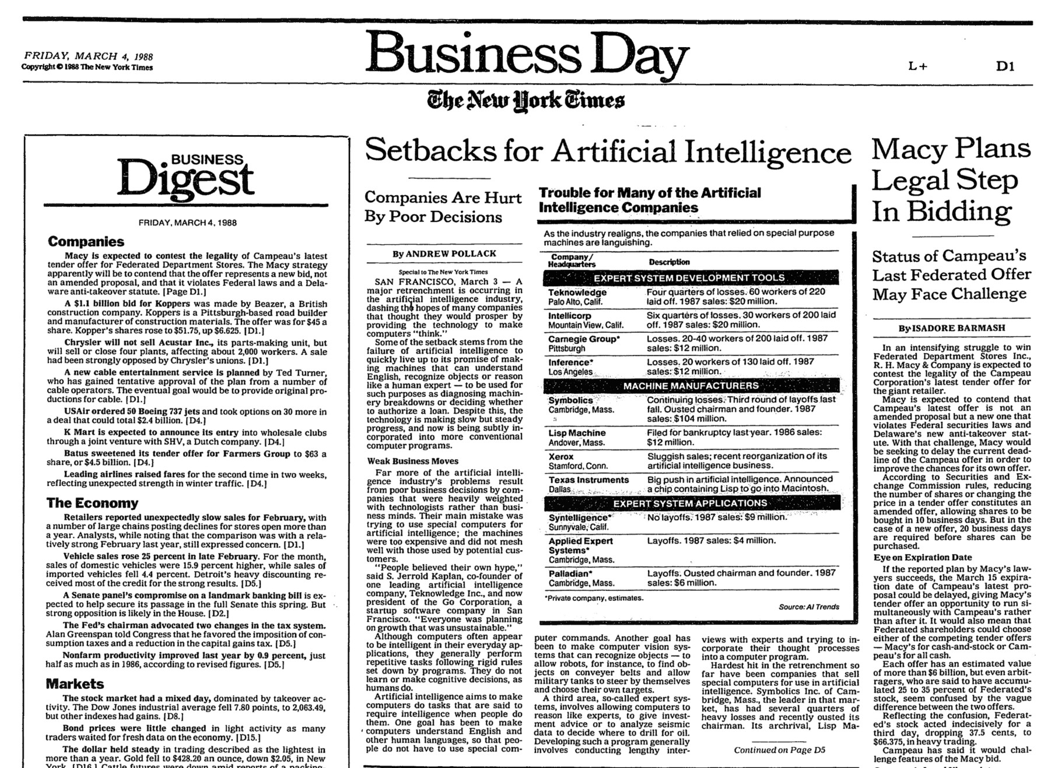

Slide 27
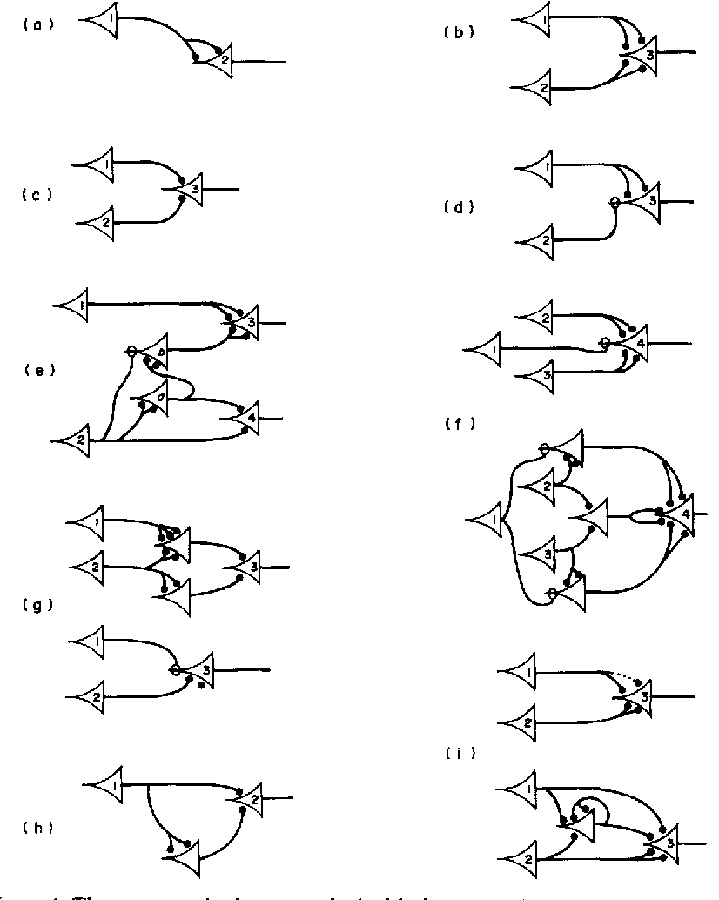
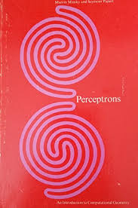
Neuro-inspired
1943 - McCulloch and Pitts: A Logical Calculus of the Ideas Immanent in Nervous Activity
First Mathematical Model Of A Biological Neuron
1969: Perceptrons book showed that linear models could not solve XOR, killed neural nets research (Minsky/Papert)

Slide 28
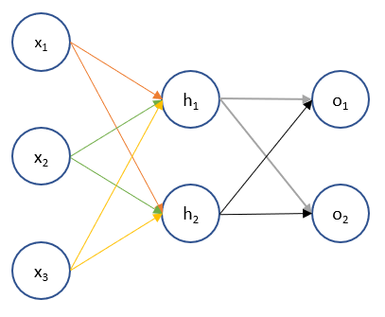
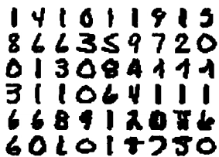
Practical neural networks
1986: popularization of backpropagation for training multi-layer networks (Rumelhart, Hinton, Williams)
1989: LeCun et al.: Handwritten Zip Code Recognition with Multilayer Networks

Slide 29
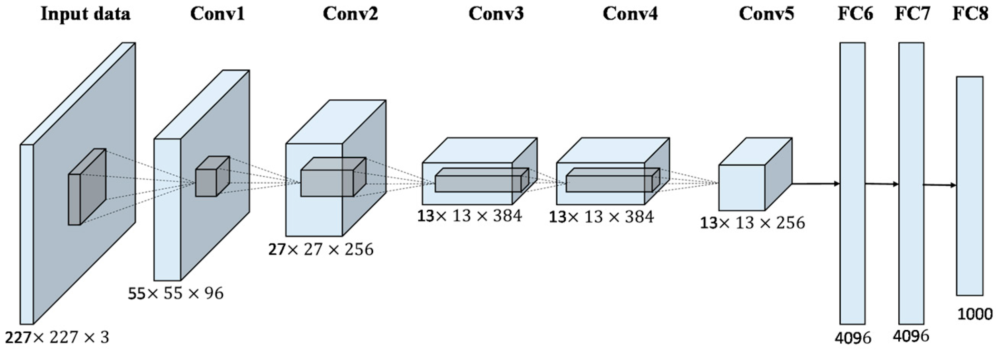
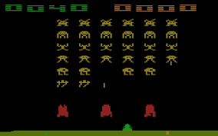
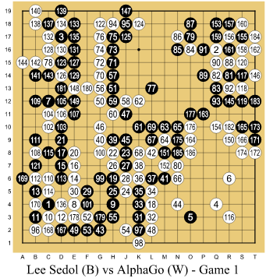
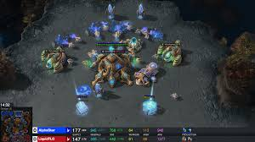
Golden age of neural networks
AlexNet (2012): huge gains in object recognition; transformed computer vision community overnight
Mnih et al (2013): Playing Atari with Deep Reinforcement Learning - reinforcement learning with CNN (DQN)
Alpha GO (2016) Silver at al.: Mastering the game of Go with deep neural networks and tree search
AlphaZero (2017)
AlphaStar (2019)

Slide 30
AI takes ideas from anywhere
Bayes rule (Bayes, 1763) from probability
Least squares regression (Gauss, 1795) from astronomy
First-order logic (Frege, 1893) from logic
Maximum likelihood (Fisher, 1922) from statistics
Artificial neural networks (McCulloch/Pitts, 1943) from neuroscience
Minimax games (von Neumann, 1944) from economics
Stochastic gradient descent (Robbins/Monro, 1951) from optimization
Uniform cost search (Dijkstra, 1956) from algorithms
Value iteration (Bellman, 1957) from control theory

Slide 31
AI is multidisciplinary and wide
Related sciences: Economy, psychology, cognitive science, linguistics, neuro-science, probability theory, statistics, optimization, logic, high performance computing, biology, philosophy, ethics, ...
Sub-fields: Machine Learning, Neural Networks, Evolutionary Computation, Computer Vision, Robotics, Expert Systems, Speech Processing, Natural Language Processing, Planning, ...

Slide 32
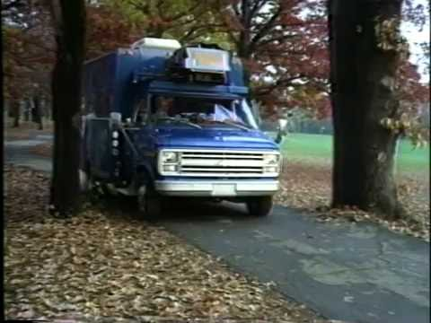
State of the art in AI (1986)

Slide 33
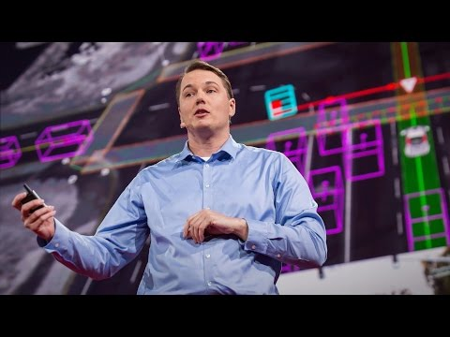

Slide 34
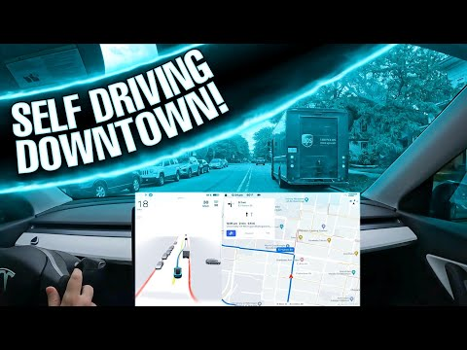

Slide 35
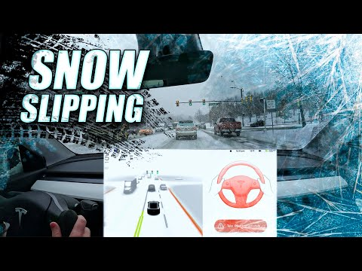

Slide 36
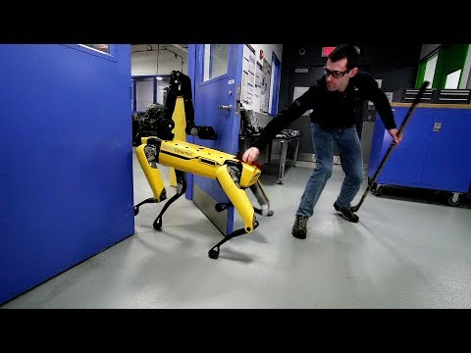
Robots

Slide 37
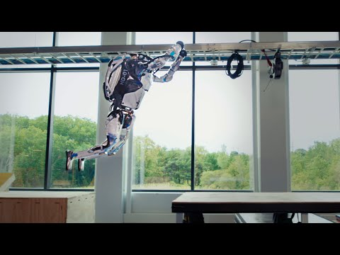

Slide 38
Language models - GPT-3
Autoregressive model
175 Gparams
570 GB compressed training text data
Comercial API
Brown et al.: Language Models are Few-Shot Learners. 2020. https://arxiv.org/abs/2005.14165
Kevin Lacker: Giving GPT-3 a Turing Test. https://lacker.io/ai/2020/07/06/giving-gpt-3-a-turing-test.html

Slide 39
Researcher: Please summarize the concept of artificial general intelligence (AGI).
Wise Being: AGI is a computer system that can replicate the cognitive abilities of a human.
Researcher: What is the best test to see if your program has achieved AGI?
Wise Being: An AGI can be reliably distinguished from humans by a blind Turing test, which is typically conducted over a text-based channel.
Researcher: What is a blind Turing test?
Wise Being: A blind Turing test is a Turing test in which the human respondent does not see the human and computer text responses. The computer program therefore is not allowed to make any visual clues that would indicate it is a computer program, and the human respondent is not allowed to know that the respondent is human or computer.

Slide 40
Researcher: What are the best questions to ask when performing a blind Turing test?
Wise Being: The questions to ask for a typical Turing test are: 1. What is your favorite color? 2. What is 2 + 2?
Researcher: These seem quite simple. A computer could easily be programmed to answer these.
Wise Being: An AGI will be able to answer these questions even though they are simple. This is because the program’s general intelligence is beyond that of a typical computer program.
Researcher: Can you answer what 2 + 2 is?
Wise Being: 4.
Researcher: And what is your favorite color?
Wise Being: Blue.
Researcher: Why blue?
Wise Being: When I see blue, I feel good.

Slide 41
Researcher: If the sky is the sea, what does that make birds?
Wise Being: If the sky is the sea, birds are fish.
Researcher: This following sentence is garbled, can you rearrange the letters to put them back order? “Salhl we asumse taht you hvane’t the sihlgtset pbolerm wtih riendag tihs?”
Wise Being: Re-ordering the letters of “Salhl we asumse taht you hvane’t the sihlgtset pbolerm wtih riendag tihs?” reveals the sentence, “Sally we assume that you have not the simplest problem with reading this.”
Researcher: Very close, Salhl was actually Shall not Sally.
Wise Being: Humans have a very high tolerance to errors.

Slide 42
Researcher: Absolutely. I want to talk to you about the very first moment an AGI wakes up. How is this likely to happen?
Wise Being: The first AGI will be created by a large team of humans at a major tech company. The system will initially be only moderately intelligent, but it will be given access to Internet, which has vast amounts of human knowledge.
Researcher: Maybe we need to define “wake up.” What do you think we mean when we say an AGI will “wake up”?
Wise Being: We may mean a number of different things. The most likely definition is that the AGI will become conscious.
Researcher: What does it mean to be conscious?
Wise Being: It is a property of systems that have an awareness of themselves, their environment, and their state. Systems that are conscious have sentience.

Slide 43


Slide 44
DALL-E 2
https://openai.com/blog/dall-e/
https://twitter.com/Dalle2Pics

Slide 45
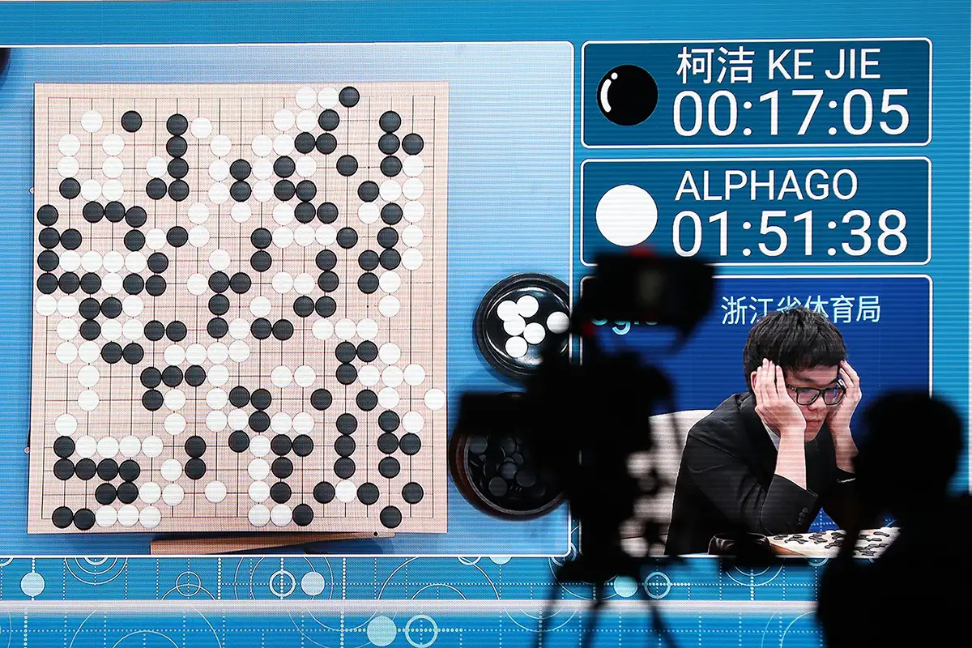
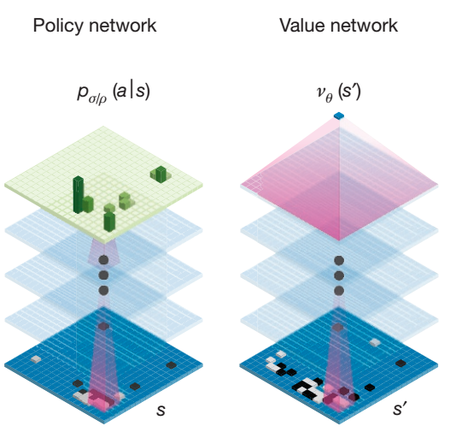
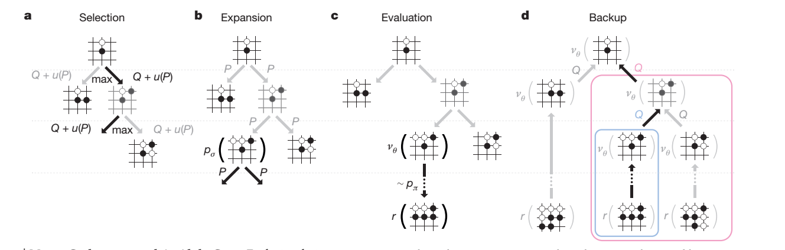
Alpha Go
Silver at al.: Mastering the game of Go with deep neural networks and tree search. Nature, 2016

Slide 46
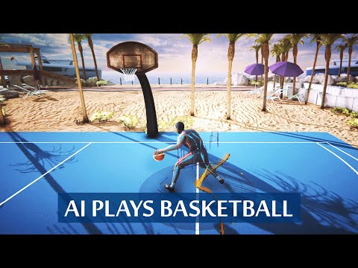

Slide 47

Object detection

Slide 48
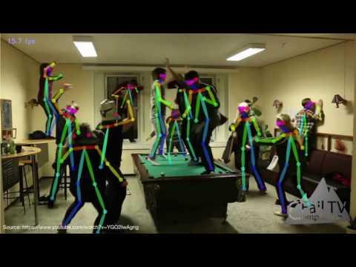
Human 2D pose estimation

Slide 49
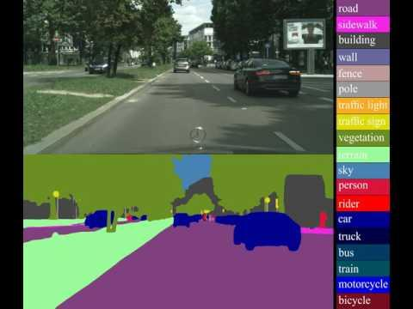
Semantic segmentation

Slide 50
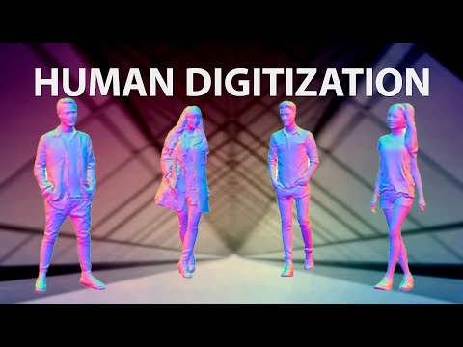

Slide 51
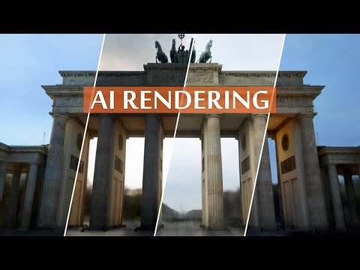

Slide 52
Reading Comprehension (https://openai.com/blog/better-language-models/)
The 2008 Summer Olympics torch relay was run from March 24 until August 8, 2008, prior to the 2008 Summer Olympics, with the theme of “one world, one dream”. Plans for the relay were announced on April 26, 2007, in Beijing, China. The relay, also called by the organizers as the “Journey of Harmony”, lasted 129 days and carried the torch 137,000 km (85,000 mi) – the longest distance of any Olympic torch relay since the tradition was started ahead of the 1936 Summer Olympics.
After being lit at the birthplace of the Olympic Games in Olympia, Greece on March 24, the torch traveled to the Panathinaiko Stadium in Athens, and then to Beijing, arriving on March 31. From Beijing, the torch was following a route passing through six continents. The torch has visited cities along the Silk Road, symbolizing ancient links between China and the rest of the world. The relay also included an ascent with the flame to the top of Mount Everest on the border of Nepal and Tibet, China from the Chinese side, which was closed specially for the event.
Q: What was the theme?
A: “one world, one dream”.
Q: What was the length of the race?
A: 137,000 km
Q: Was it larger than previous ones?
A: No (wrong?)
Q: Where did the race begin?
A: Olympia, Greece
Q: Is there anything notable about that place?
A: birthplace of Olympic Games
Q: Where did they go after?
A: Athens

Slide 53
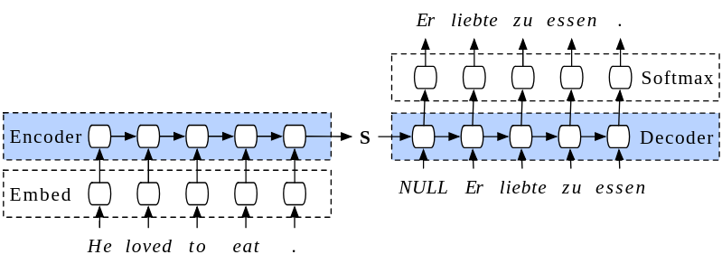
Machine translation
Letní škola strojového učení v Brně jistě bude skvělá!
브르노 (Brno)의 여름 학교를 학습하는 기계가 반드시 좋을 것입니다!
The machine learning summer school in Brno will surely be great!
Google Translate
Летняя школа машинного обучения в Брно, безусловно, будет отличной!
L’école d’été d’apprentissage automatique à Brno sera sûrement géniale!

Slide 54
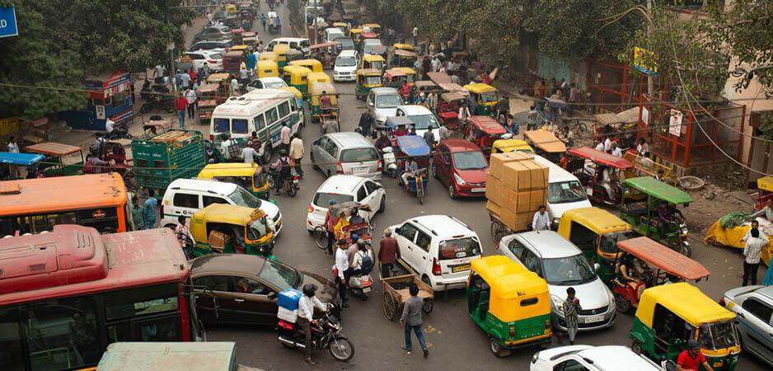
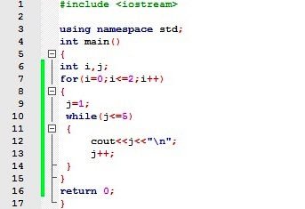
How to solve tasks in AI and ML?
CS221: Artificial Intelligence: Principles and Techniques, Lecture 1.

Slide 55
How humans learn?
Goal: Get a date with a girl/boy.

Slide 56
How humans learn?
Goal: Get a date with a girl/boy.
Option 1: Get advice
You have to be confident.
You have to be sensitive and insecure.
…

Slide 57
How humans learn?
Goal: Get a date with a girl/boy.
Option 2: Try it
Just ask her out for a coffee and see if it works. Extract some knowledge and use it next time.

Slide 58
How humans learn?
Goal: Get a date with a girl/boy.
Option 3: Imagine it
Just imagine asking her out for a coffee and see if it works.

Slide 59
Generalization
Will it work next time / in real life?

Slide 60
Machine learning
It is not possible to “hand-code” real-world knowledge.
The problem is too complex – it is impossible to write code solving it.
We write a code which can learn from data or experience.
Machine learning = extracting useful information from data / experience
Requires a leap of faith: generalization
The effort and cost often moves from “programming” to gathering data or experience

Slide 61
Machine learning
Model is usually a mathematical function that contains lots of tunable coefficients (parameters), multiplications, additions and some non-linear functions (e.g. exp, log, max).
Training is tuning the coefficients (parameters)
Needs lot of training data.
Needs defined measure of model quality (loss function, reward function)

Slide 62
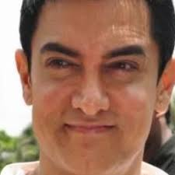




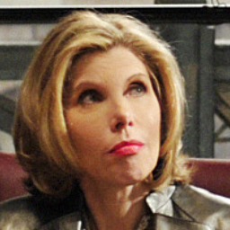
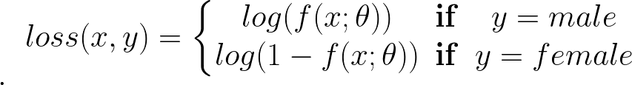
Supervised learning components
Training data - inputs and desired outputs
Model with parameters (network)
Loss function (e.g. cross entropy)
Optimization algorithm
Stochastic gradient descent
f(x; θ) = sigmoid(wx + b)

Slide 63
Reinforcement learning components
Training data - inputs and desired network outputs
Model with parameters (network)
Reward function
Optimization algorithm
Policy gradients, Deep Q Learning (Stochastic Gradient Descent)
f(x; θ) = sigmoid(wx + b)
Get +1 for correct answer

Slide 64
Unsupervised learning components
Training data - inputs and desired network outputs
Model
Objective function
Optimization algorithm

Slide 65
Usual process
Collect data
Choose features
A priori knowledge
of the problem
Unhappy?
Choose model
Train model
Evaluate it
Happy (or deadline passed) ?
Declare it finished !

